Slide 1
Business Central Power BI apps on Telemetry
January 2023 updates

Slide 2
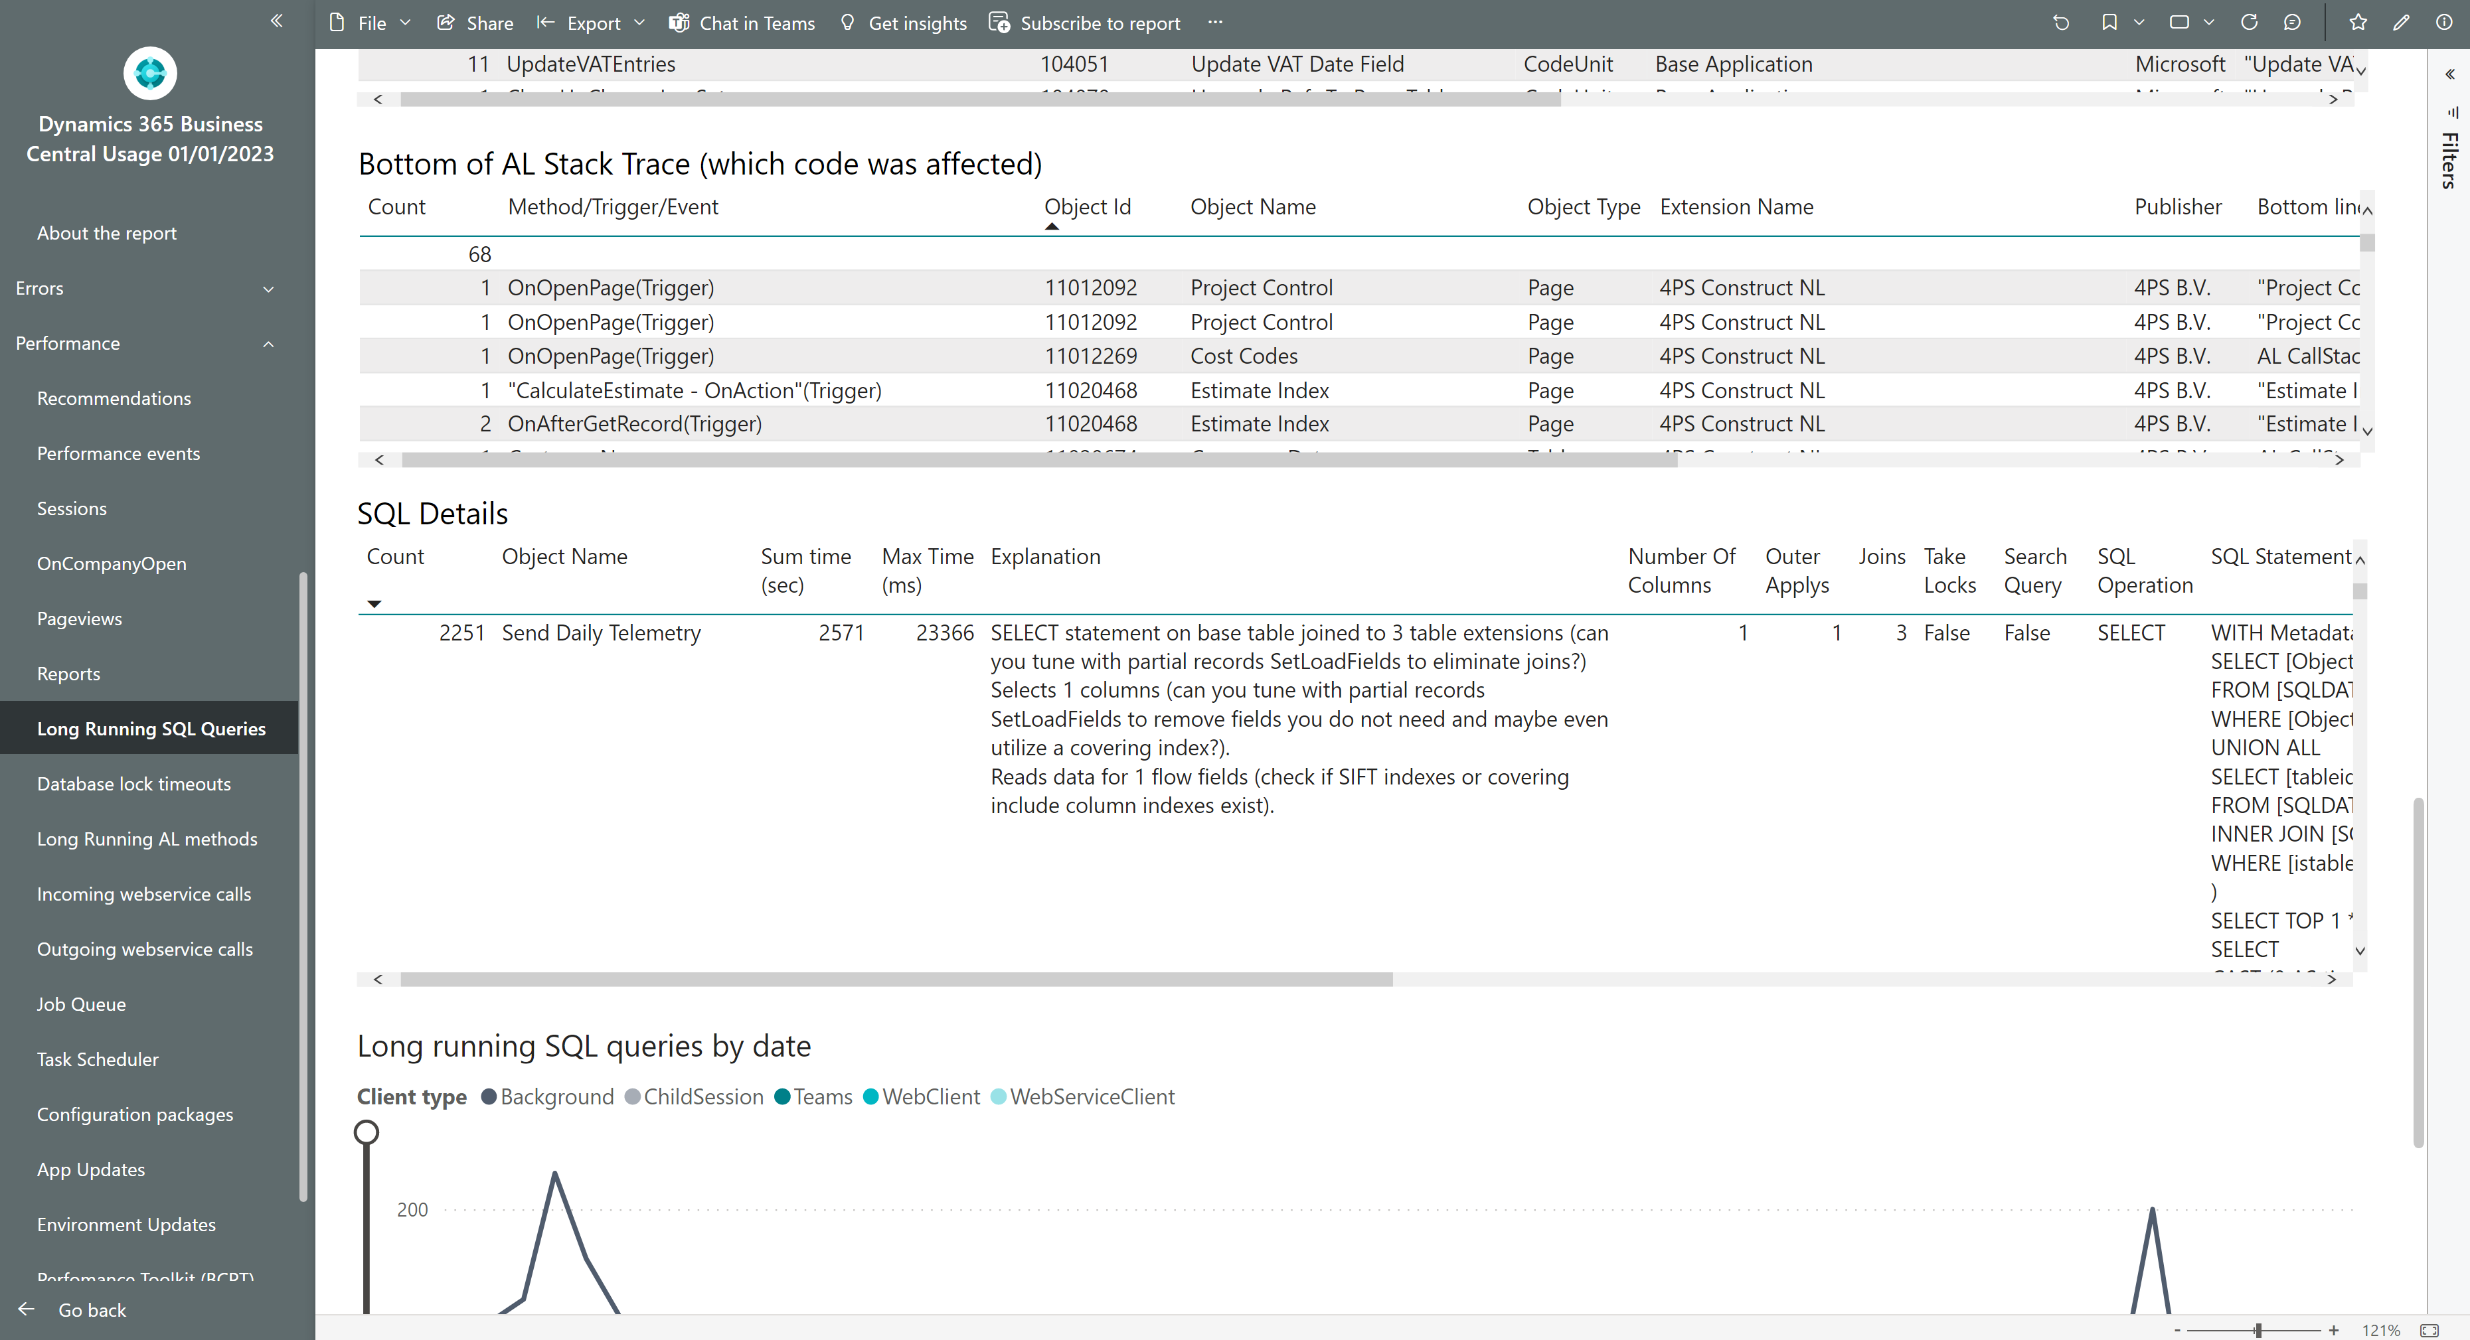
New column Explanation on SQL statements

Slide 3
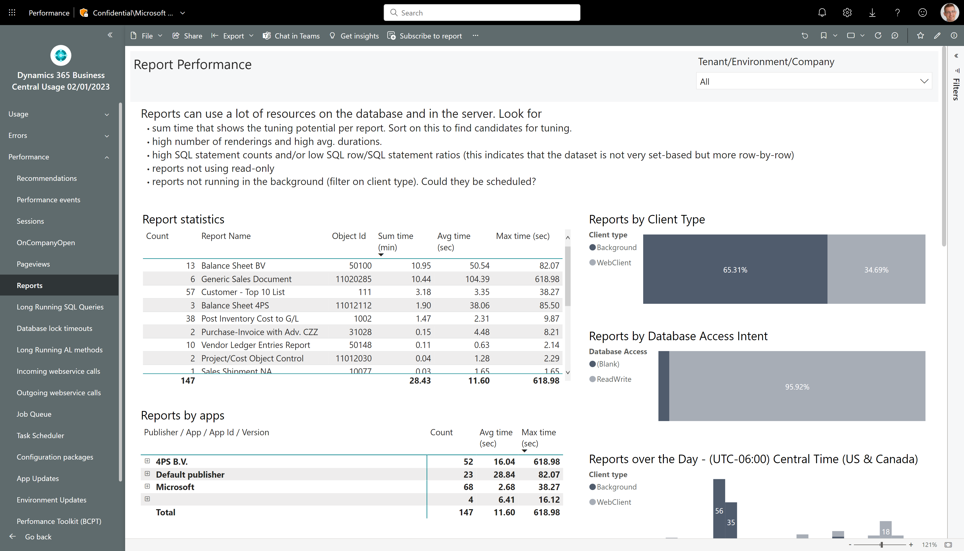
Performance statistics on reports

Slide 4
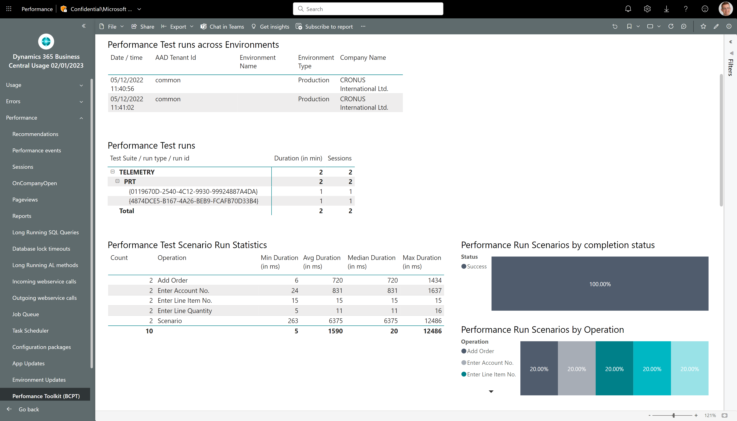
New report showing data for Performance Toolkit runs

Slide 5
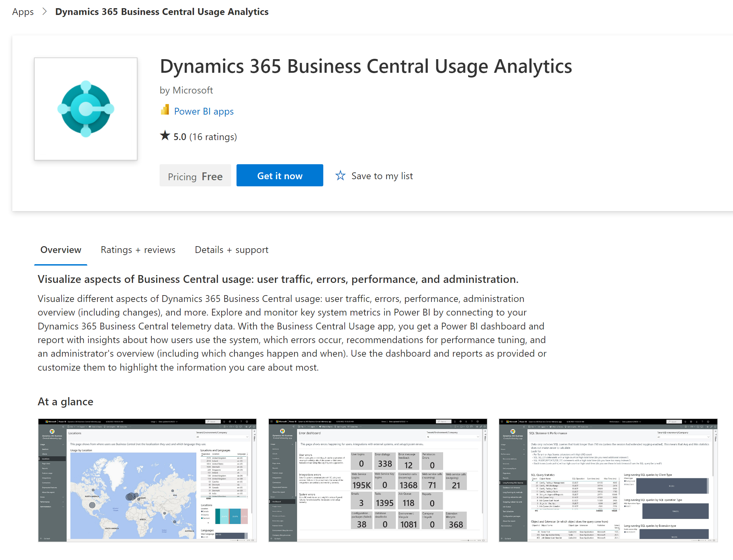
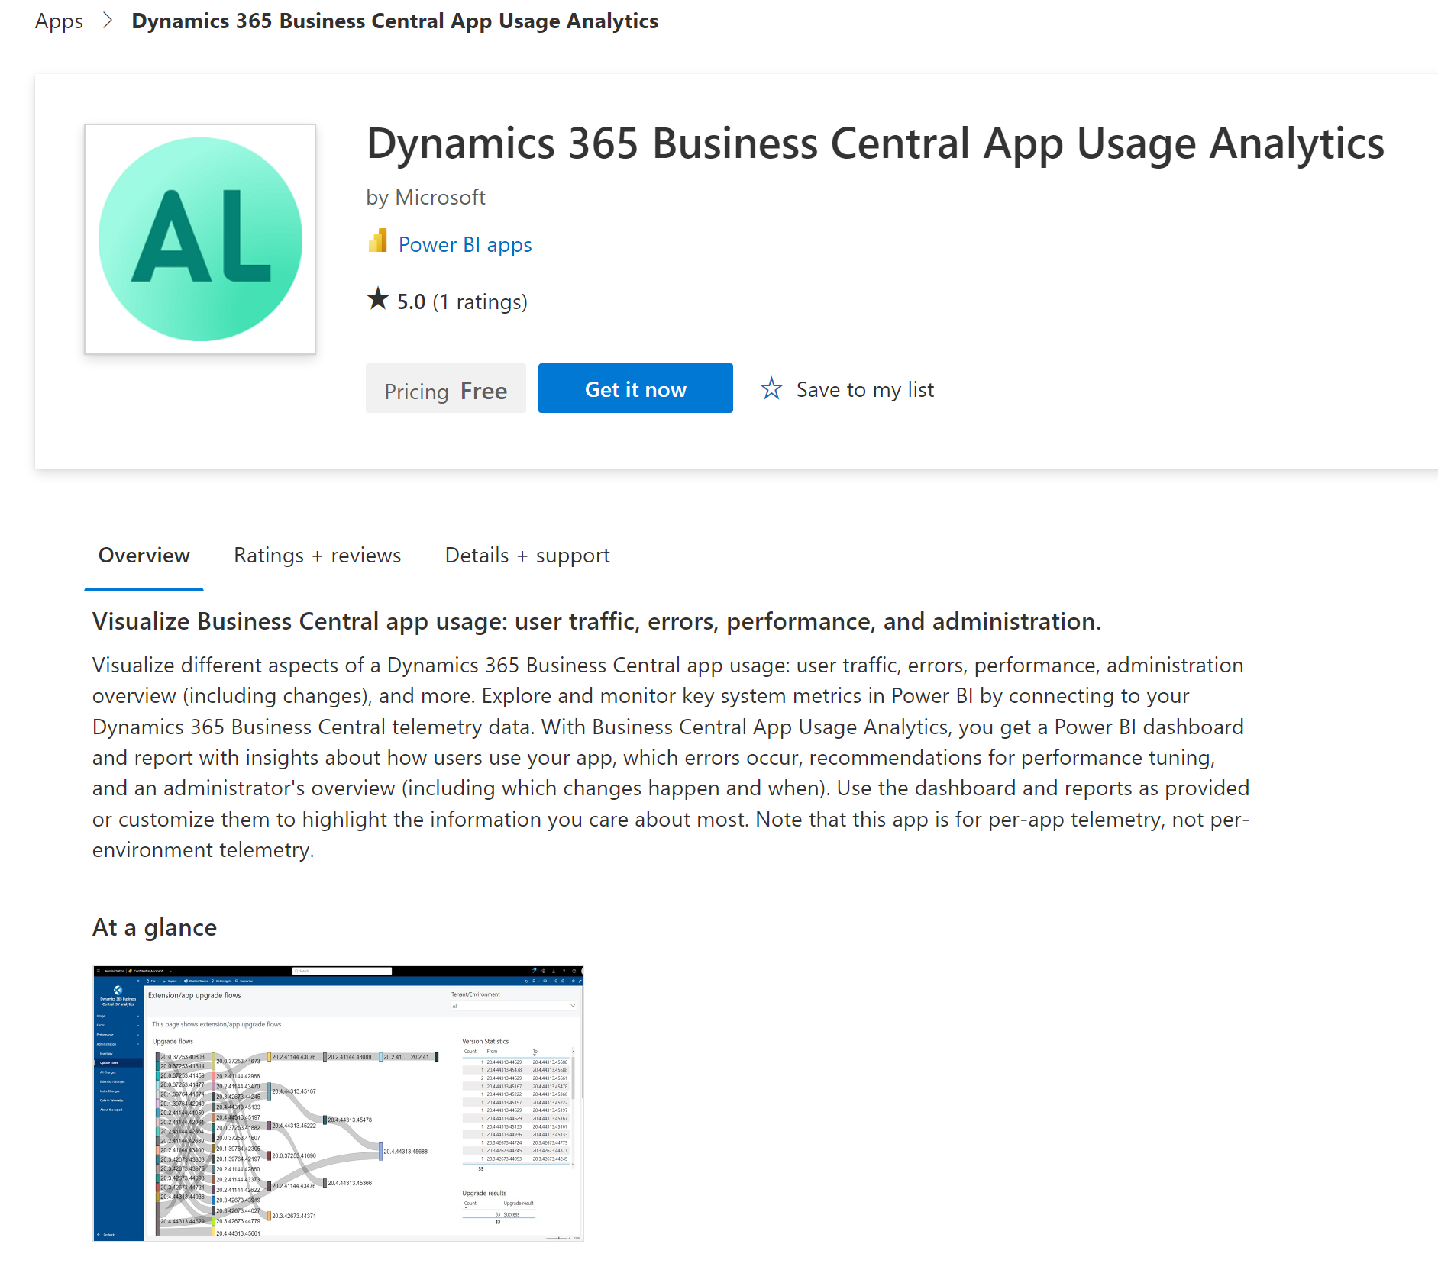
Get the apps
Environment usage
aka.ms/bctelemetryreport
App usage
aka.ms/bctelemetry-isv-app

